Slide 1
Product Training
TabScan A411/A411BT

Slide 2
Catalog
1. Product appearance
2. Product differentiation
3. Product details
4. Product functions
5. Product use
6. Product features
7. Product specifications
8. Packing list
9. Sales channels
10. Video related

Slide 3
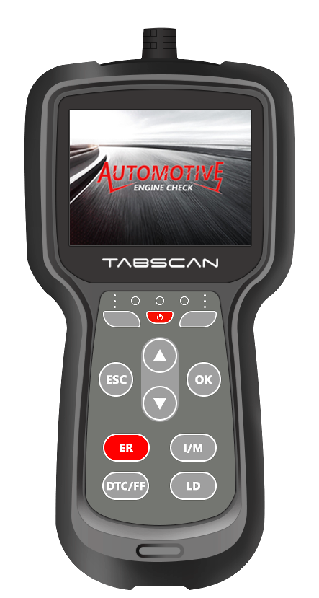
1. Product appearance
The streamlined design of the product is more ergonomic and convenient for one-handed operation. The whole machine is equipped with a 2.8-inch TFT color screen, total 11 keys, 5 hot keys, which are reboot, erase, I/M readiness, DTC/FF, live data, 3 color LED instruction lights, Type-C port, 1 meter long test cable.

Slide 4
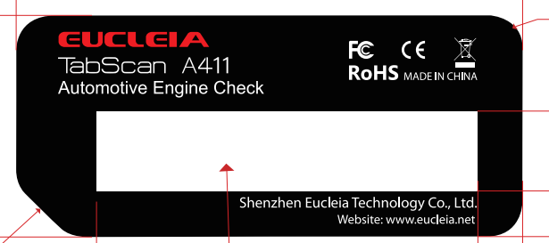

2. Product differentiation
The A411 series is divided into two versions, A411 without bluetooth module and A411BT with bluetooth module. The appearance of the two products are the same, and they are distinguished by back side sticker information.
Sticker：

Slide 5
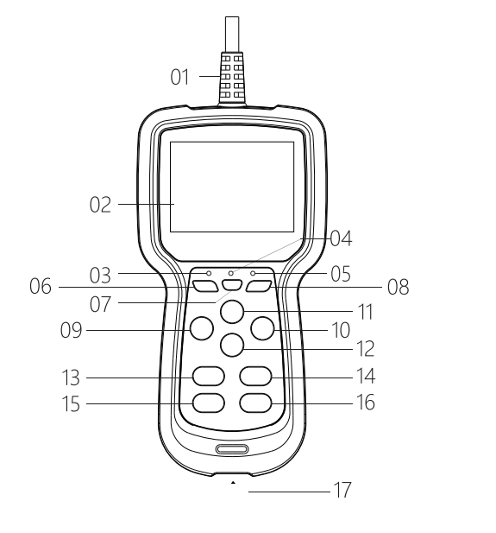
3.Product details
A411/A411BT consists of 17 parts.
1. OBDII test cable, connect with vehicle data link connector(DLC), device will get power from DLC.
2. 2.8 inch color LCD screen.
3. Green - indicates that all engine systems are running normally(all monitors on the vehicle are active
and performing their diagnostic testing, and no DTCs are present).
4. Yellow - indicates there is a possible problem. A “Pending” DTC is present and/or some of the
vehicle's emission monitors have not run their diagnostic testing.
5. Red - indicates there is a problem in one or more of the vehicle's systems.The red LED is also used
to show that DTC(s) are present. DTCs are shown on the Scan Tool's display. In this case, the
Malfunction Indicator(“Check Engine”) lamp on the vehicle's instrument panel will light steady on.
6. F1 assist button - it can be used as confirm, cancel, graph view, help view and move cursor function
in specific menu.
7. Power button - reboot device.
8. F2 assist button - it can be used as confirm, cancel, graph view, help view and move cursor function
in specific menu.
9. ESC - back to the previous menu.
10. OK - confirm button, enter next menu.
11. Up - up key, control the cursor to move upward. Long press to quickly turn pages.
12. Down - down key, control the cursor to move downward. Long press to quickly turn pages.
13. ER - one click erase DTCs, hot key.
14. I/M - one click to view I/M readiness status, hot key.
15. DTC/FF - one click to view DTC or freeze frame, hot key.
16. LD - one click to view live data, hot key.
17. Type-C - USB port, connect with computer, device can get power from computer, user can update
software, change device language and print report from PC manager.

Slide 6
4. Product functions
Widely vehicle coverage sedans, SUVs and light trucks post 1996 in US, post 2000 for EU-based and Asian cars, fast speed reaction, friendly UI design, ergonomic one hand operation.
Read and clear fault codes from engine. Turn off MIL(Check engine light). Support 10 modes of OBD2 test. Retrieves vehicle information (VIN, CID and CVN). Read the I/M readiness status, help your vehicle pass the annual smog check.
Mode 01 - request current powertrain diagnostic data.
Mode 02 - request powertrain freeze frame data.
Mode 03 - request emission-related diagnostic trouble codes.
Mode 04 - clear/reset emission - related diagnostic information.
Mode 05 - request oxygen sensor monotoring test results.
Mode 06 - request on-board monitoring test results for specific monitored systems.
Mode 07 - request emission-related diagnostic trouble codes detected during current or last completed driving cycle.
Mode 08 - request control of on-board system, test or component.
Mode 09 - request vehicle information.
Mode 0A - request Emission related DTCs with permantent status.

Slide 7
Turn off MIL(Check engine light).
Read the I/M readiness status, help your vehicle pass the annual smog check.
Generic and manufacturer fault code definitions displayed on screen. Thousands of fault code definitions stored within the software. Search fault code definitions from the device’s database, no matter the code is currently stored or not.
Generate a diagnostic report automatically after the engine check and back to the home page. Report can be printed on PC.
Five one click hot keys designed, one click reboot device, one click clear DTCs, one click check I/M readiness, one click read DTCs, one click display freeze frame, one click view live data stream.
LED indicator in 3 colors for different situations. Green indicates no DTCs, yellow indicates there are pending DTCs or some monitors are not ready, red indicates there are DTCs at present.
Bluetooth connect with mobile, view diagnositc report on mobile, report can be shared, supports IOS/Android(A411BT).
Change multilangue by PC manager. Supports English, French, Spanish, Portuguese and Russian.
Lifetime FREE upgrade to keep you stay current with the latest development of diagnosis.

Slide 8
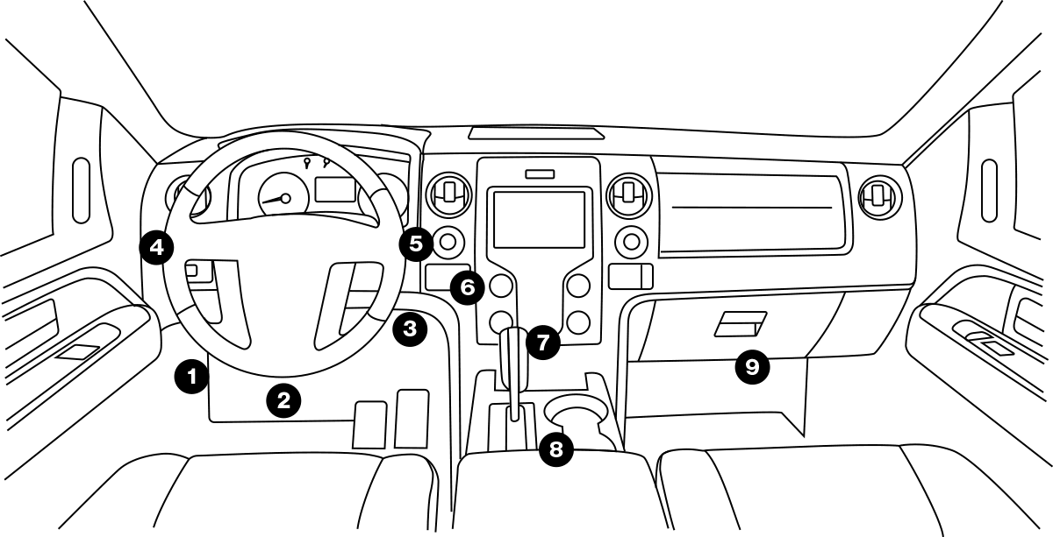
5. Product use
Connect with vehicle DLC, plug and play.
Save user time and solve time-consuming pain
points.
Help owners to solve the problem of car
breakdown.
Help the technician to quickly identify and solve the problem.
Help user to check the health of the vehicle, obtain information about the engine DTCs to repair the vehicle.
Monitor the working conditions of on-board monitors, repair abnormal monitors in advance, and help your vehicle to pass the annual smog check.

Slide 9
6. Product features
【WIDELY VEHICLE COVERAGE】Compatible with all OBD2-compliant vehicles: sedans, SUVs and light trucks post 1996 in US, post 2000 for EU-based and Asian cars from 2008.
【UNIQUE COMPACT DESIGN】Comes with compact sized design, more ergonomic to hold and operate in one hand.
【ONE-KEY REBOOT】 Reboot hotkey, fast reboot to avoid tedious operations.
【ONE CLICK ERASE DTCs】Comes with one click to erase emission related DTCs. Turns off check engine light (MIL) and resets monitors.
【ONE CLICK I/M READINESS】TabScan A411 engine check scanner comes with one click I/M Readiness to check the conditions of the emission system, check the conditions of the Emission System which includes continuously tested monitors like misfire monitor, fuel system monitor, comprehensive components monitor and non-continuous monitors like O2 sensors, EVAP system, EGR system and etc. Help your vehicle to pass the annual smog check.
【ONE CLICK READ DTCs】TabScan A411 engine check scanner comes with one click to view DTCs, show the detailed description of the Diagnostic Trouble Code (DTCs).
【ONE CLICK FREEZE FRAME】TabScan A411 engine check scanner comes with one click to read freeze frame data which shows engine conditions such as fuel trim, fuel pressure, engine coolant temp, etc. at the time the malfunction indicator lamp(MIL) was set.

Slide 10
【ONE CLICK LIVE DATA STREAM】Comes with one click to show the information of continuous data stream from a vehicle in live graphic display.
【ON-BOARD MONITOR TEST】The On-Board Monitor Test for non-CAN-equipped vehicles retrieves and displays test results for emission-related power train components and systems that are not continuously monitored.
【DTC LOOKUP】Built-in DTC library with a database of over 3000 code definitions, the OBD2 Scanner reads generic and manufacturer-specific trouble codes directly identify the code definitions on the screen, saving time searching online.Instead of paying a mechanic to have the DTCs read and MIL turned off, Fast read and clear the trouble codes(engine fault codes) , find out what the problem is and perhaps fix it.
【EASY TO OPERATE】Plug-and-play that allows you to test cars directly once you get it, very easy to use even for beginners. No battery or charger is required as it directly gets power from vehicle DLC. Shows live vehicle sensors data in text and graph format, I/M Readiness check the state emissions readiness, you’re able to do it on your own, save money and time. With a compact size, easy to hold and carry.
【FAST SPEED REACTION】Coming with the user friendly diagnostic interface and optimized software algorithm, it makes diagnosis speed faster than other OBD2 scanners. Featuring 2. 8'' LCD color screen and graphical real time sensor analysis, may help you fast identify faulty readings in seconds.
【DIAGNOSTIC REPORTS】Generate a diagnostic report automatically after the engine check and back to the home page. Report can be printed on PC or mobile.
【LIFETIME FREE UPDATES】Comes with lifetime free software updates, 15 Months free from defects after-sales services. Should there be any questions or issues, please feel free to contact our 24/7 customer service team via eucleia@eucleia.net.

Slide 11
7. Product specifications
Display: 2.8'' TFT color display, resolution 320*240.
Support OBD2/EOBD vehicle, light trucks, SUVs, minivans and hybrid vehicles.
ARM Cortex M3, 32 Bit, 8兆Flash
Support protocols：J1850-PWM, J1850-VPW, ISO-9141, KWP 2000(ISO 14230), CAN(ISO 11898 and ISO15765)
Working voltage：DC 9V-18V
Rated current：12V/150mA
Working temperature：-10℃~55℃
Working humidity：10%~90%
Bluetooth：Class2,IOS/Android dual mode（A411BT）.

Slide 12
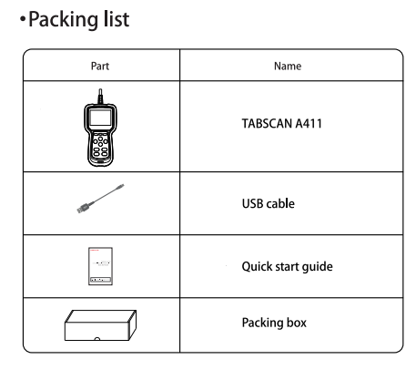
8. Packing list
1. A411/A411BT
2. USB cable
3. Quick start guide
4. Packing box

